Slide 1

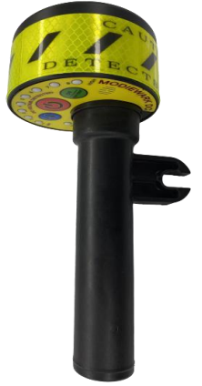
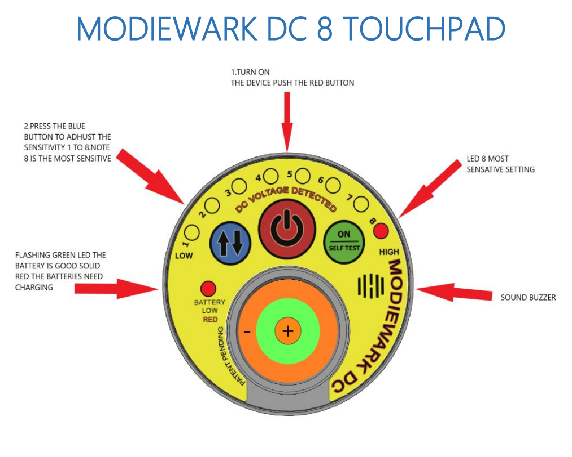
Rev 01 23/03/20
DATASHEET: DC 8 | Non-contact Voltage & Static Indicator
DC8 is a non-contact DC voltage detector that alerts users when they approach an electrified source. Its advanced notification system is designed to warn the user of the presence of voltage and
current within a proximate area. DC internal sensors were designed to detect both electrical (V/m) and magnetic (T) fields.
Radiated electric and magnetic fields increase with higher distribution voltages and decrease with distance and/or shielding. Once an energized source is detected, the user is notified first by LED lighting of the approximate distance and then is followed by indicating piezo buzzer. These warnings are shown to the user by the line of LED lights
The Modiewark DC detector is designed to pick up an electric field emanating from an active DC source as low as 50v dc. For the use on electric vehicles including hybrid 200vdc to 800vdc, Trains and Trams 600VDC To 1500VDC, solar Panels Domestic and Commercial 100VDC to 1000VDC. 2.DC 8 Non-Contact Voltage Detector has 8 sensitivity settings, and can be adjusted on the job, it has been designed for all industry that works with Direct Current electricity (DC).
Turn on the device by pushing the red button.
Press the blue button to adjust the
sensitivity 1-8.
Note 8 is the most sensitive.
LED 8 is the most sensitive setting.
Flashing green LED means the battery is good. Red LED means the batteries need charging.
Sound buzzer.

