Slide 1

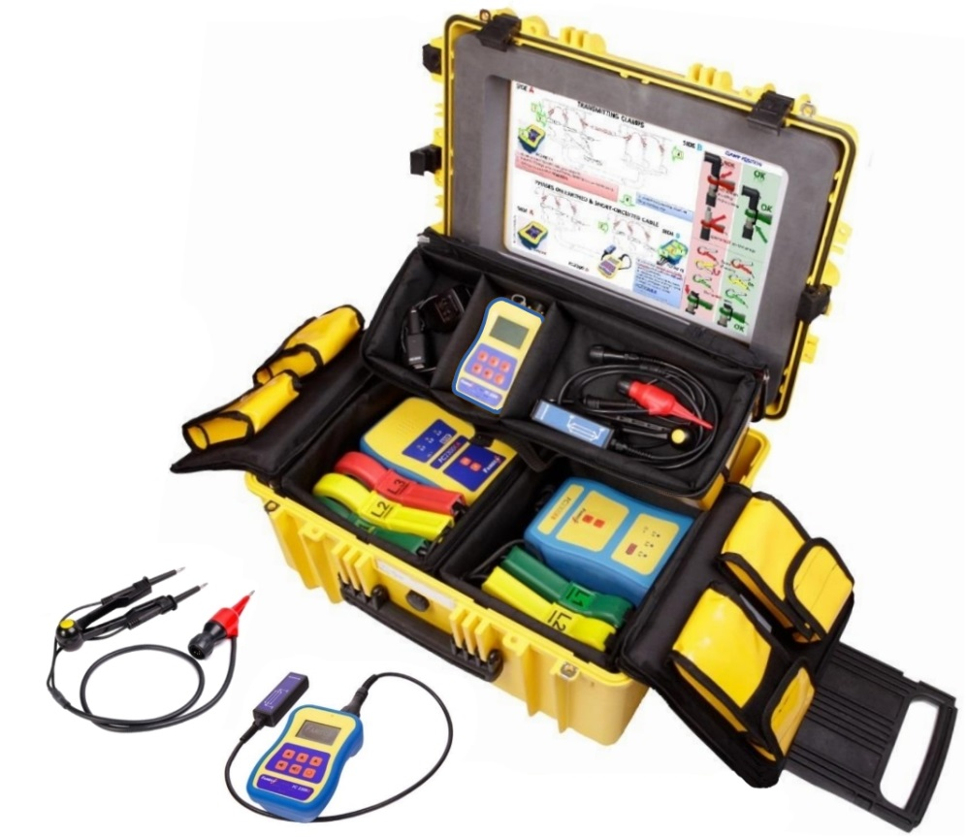
Rev 01 04/05/16
DATASHEET: CLY 300 FC-2310 | Dead cable and phase identifier
Application
Used on dead / de-energised cables to provide a clear identification of a specific cable, individual phase or the continuity of each conductor.
This device would typically be used for:
Dead cable jointing teams before and during work
Fault tracing on broken, de-energised cables
The FC2310 can be trusted to give positive and reliable identification even when there are multiple cables running in and around each other in close proximity.
It is equipped with a function-specific probe set that allows a single user to ID the individual phases on both of the faces of a cut cable before final jointing is commenced.
The “transmission” unit can be encoded with a customisable voice message so that multiple FC2310 systems can be used on the same network without fear of misidentification at any point.
Usage
For this purpose, the FC2310 consists of 3 main units
FC2300 EA transmitter for cable end “A”
FC2300 EB transmitter for cable end “B”
FC2300 D hand unit.
All conductor ends and any cable shielding must be shorted together with the provided shunt assemblies and connected to ground before identification can begin.
The units can then be configured for a basic cable ID, phasing, continuity checking or cut cable phase ID. Full details of how to achieve each scenario are provided in the comprehensive manual.
The units are all contained in one heavy duty case to protect the unit from damage.

